Slide 1
Lets do clustering
Central London Data Science Project nights

Slide 2
What is clustering?
Unsupervised machine learning technique
i.e it doesn’t need the data to have labels
Tries to find homogenous groups within data

Slide 3



Clustering use cases
Customer base analysis for targeted marketing
Cluster a text data set to find genres/topics within a data set
Cluster on flower data to find different species

Slide 4
K-means algorithm
Initialise centroids
For each centroid:
Find the data points that are closest
Calculate the average position of these data points
Update centroid to this average
Stop when the centroids haven’t change by much

Slide 5
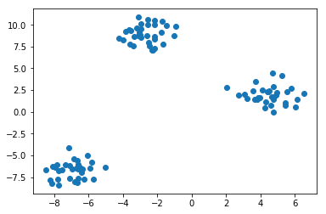
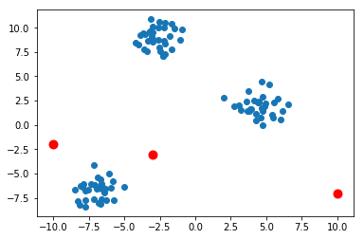
Random initialising centroids

Slide 6
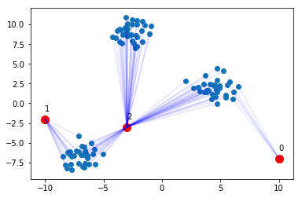
Find closest data points for each centroid

Slide 7
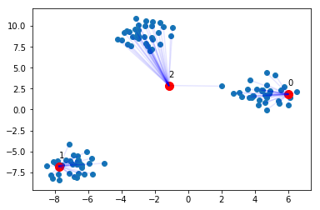
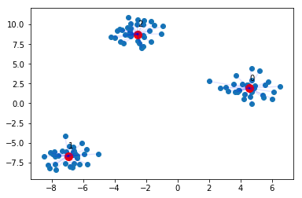
Update to average position of closest data points

